Slide 1
Friedrich Nietzsche: THE SELF AS ART
AGENDA:
The Herd Mentality
Authenticity and Self-Creation
An Artistic Perspective on Life
A Test of Your Success

Slide 2
What Do You Want? Why Do You Want That?
Happiness: usually means “getting what you want…”
But why do we want the things that we want?
Are those our deepest, truest desires?
How did they get there?
Nietzsche thinks that our desires are most often the least interesting, least individual thing about us:
we simply want the things that our cultures tell us to want!

Slide 3
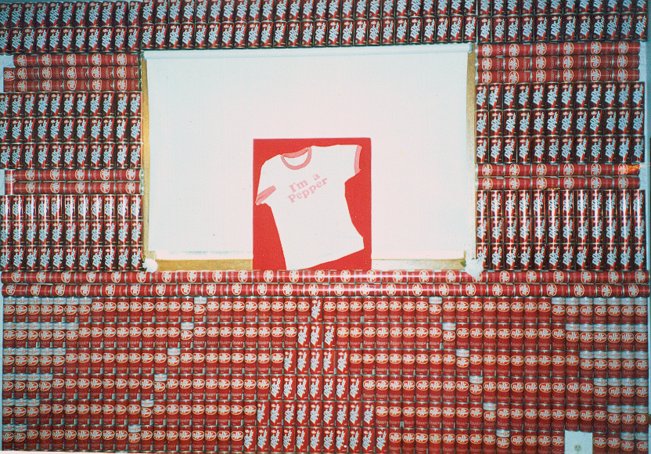
What Do You Want? Why Do You Want That?
Our precious “individuality”?
merely a collection of various dreams, character traits & tastes, each quite common on their own
more than likely, we learned them all from television, social media, movies, pop songs, and advertising!
Notes:
623 Dr.Pepper cans on my wall

Slide 4
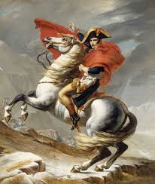
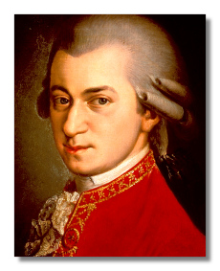
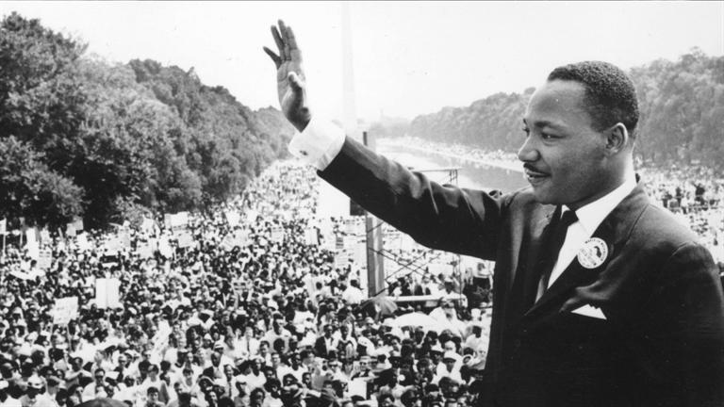
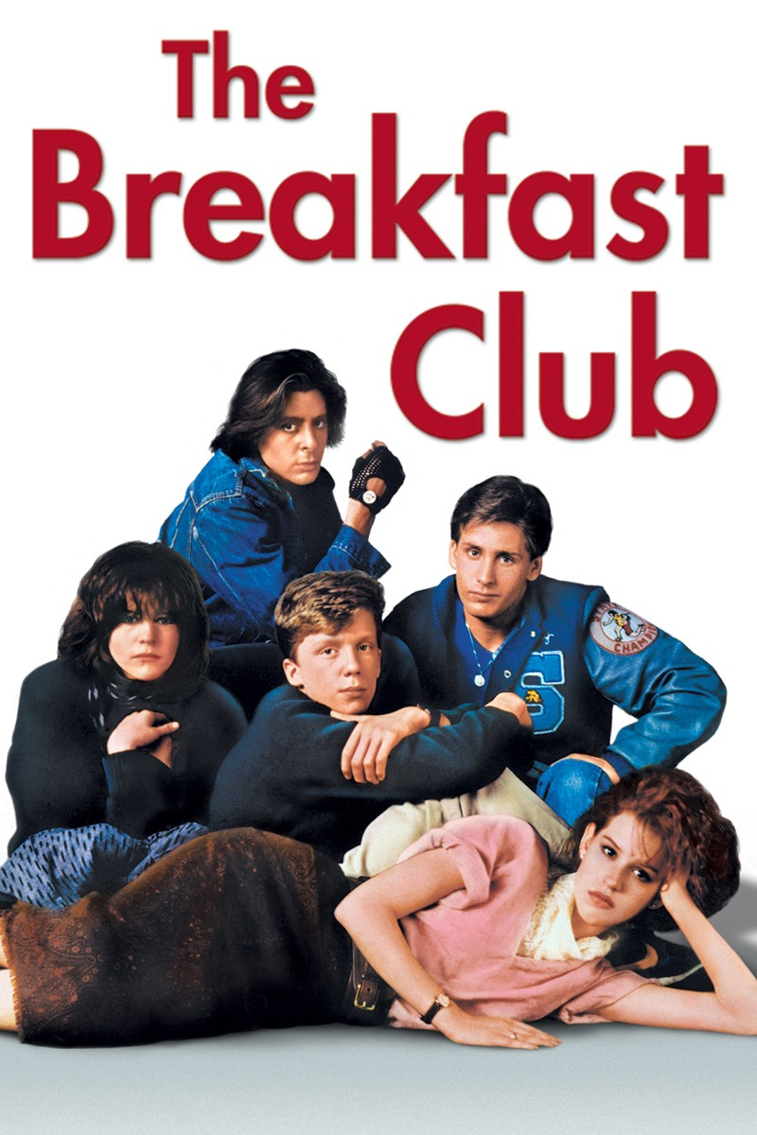
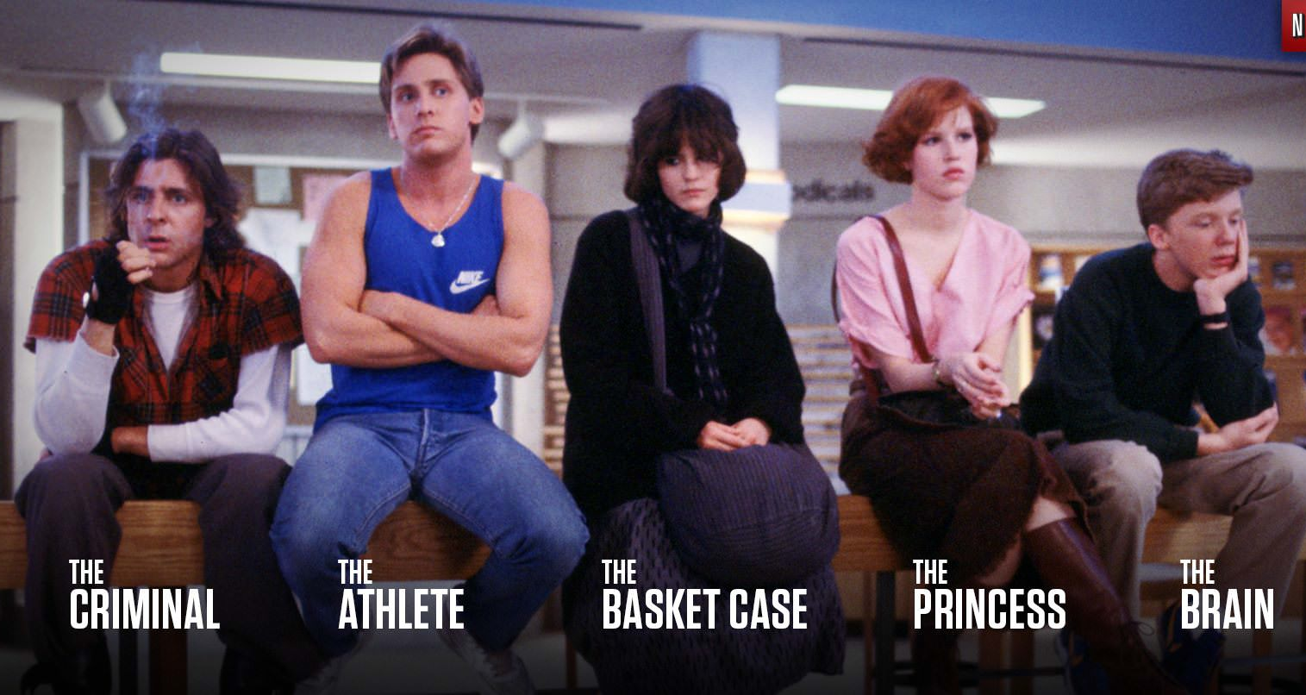
While a rare few are completely original, the vast majority of us fit into well established roles

Slide 5
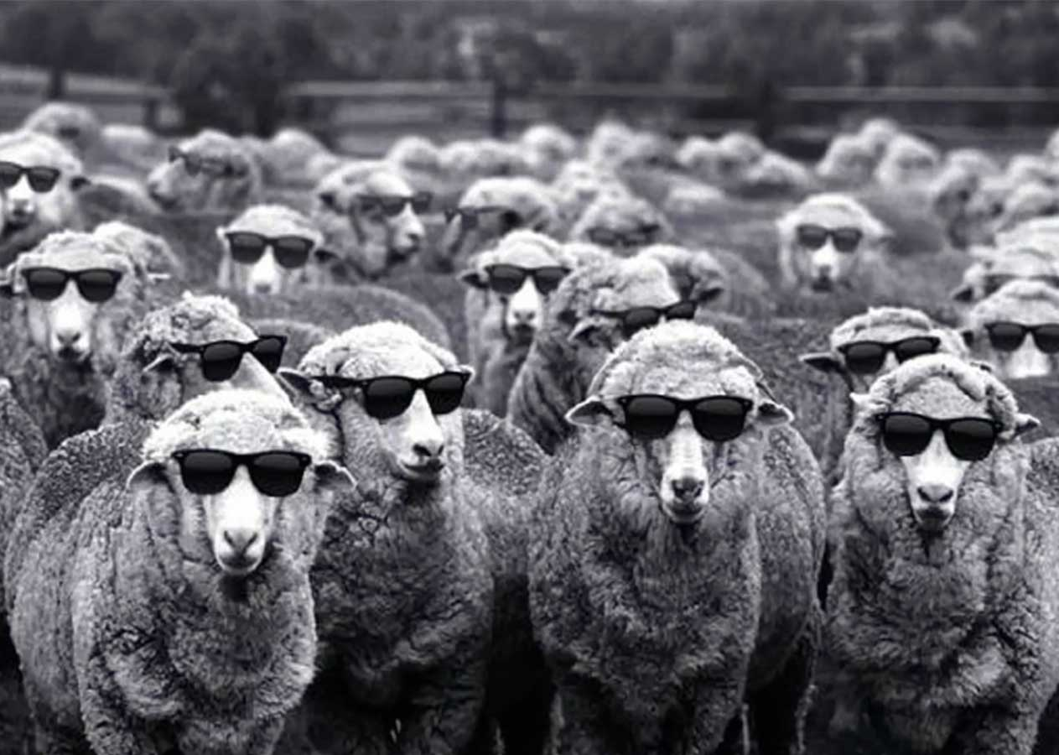
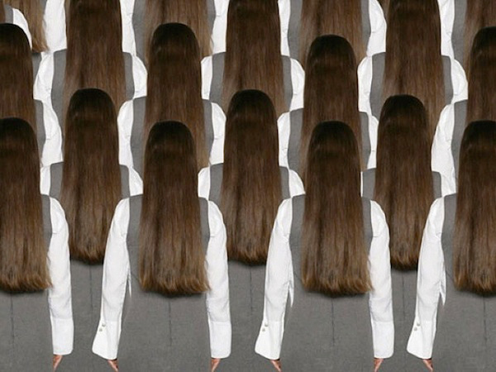
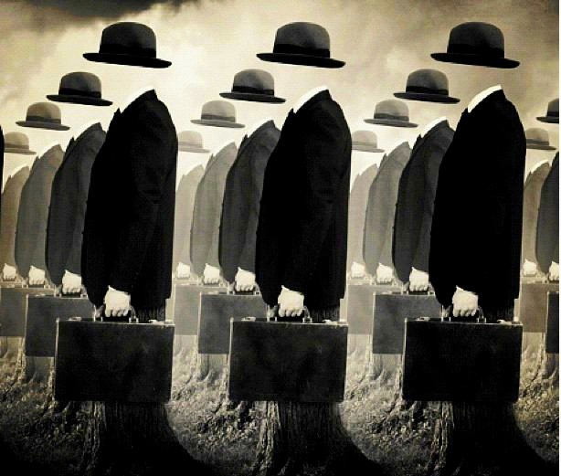
The “Herd” Mentality
The fact that we think the same as others, and punish the few genuine individuals, reminds Nietzsche of the behaviour of herd animals
A herd animal can’t think for itself; it does what others do, and gets very anxious when it’s on its own

Slide 6
It Doesn’t Have To Be This Way!
We can become genuine individuals, and Nietzsche encourages us to try
But to do this, we need to overcome two things: Fear, and Laziness:
Fear of being alone, without the security of fitting in with the surrounding culture
Laziness, that makes us flee from the work it would take to really become individuals

Slide 7
Nietzsche: from Untimely Meditations
“What is it that forces the individual to fear his neighbor, to think and act like a member of a herd, and to have no joy in himself? ...
For the majority it is idleness, inertia, in short laziness…
men are even lazier than they are fearful, and fear most of all the burdensome nuisance of absolute honesty and nakedness
...
Artists alone hate this lazy tendency toward borrowed manners and appropriated opinions…
they dare to show us that man, when he is most unique, is beautiful… and never boring.

Slide 8
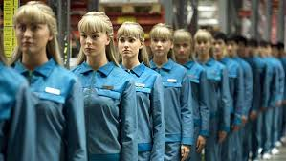
“When the great thinker despises human beings, he despises their laziness:
for it is on account of their laziness that men seem like manufactured goods, unimportant, and unworthy to be associated with or instructed.
Human beings who do not want to belong to the mass need only to stop being comfortable; follow their conscience, which cries out:
"Be yourself! All that you are now doing, thinking, and desiring is not really yourself.”

Slide 9
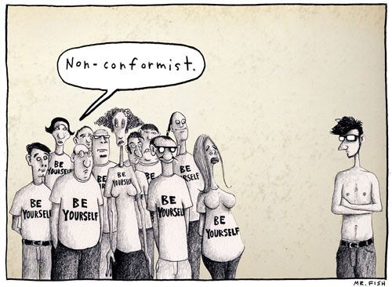

Slide 10
Against Lazy Authenticity
Most of us feel we should be true to our ‘real selves,’ but why should we assume that our current personalities are ‘authentic’ –our real selves?
I inherited that self; I didn’t choose it
For Nietzsche, I am not a genuine individual until I ‘customize’ this personality.
My Real Self is something I must Create
For Example…
Notes:
Read last paragraph of selection

Slide 11
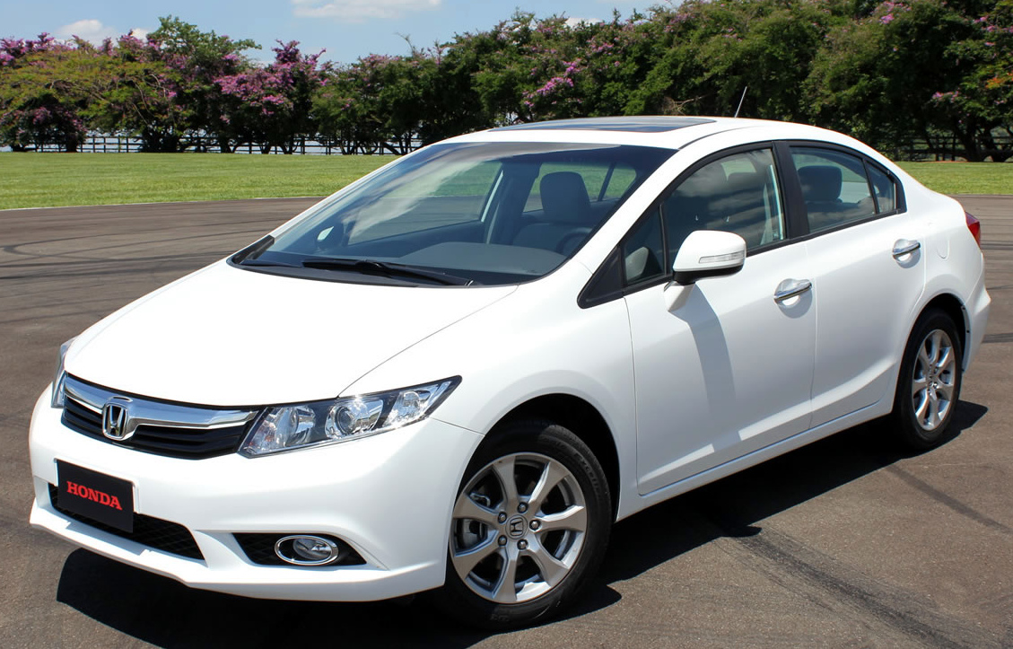
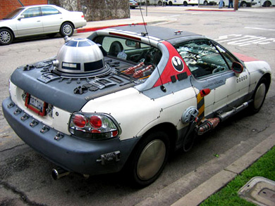
Customizing makes you an Individual…
Why drive everybody else’s Honda Civic when you can make it your own?
Why “drive” the personality you just happened to end up with when you can make it your own?

Slide 12
“Let the youthful soul look back on life with the question: what have you truly loved up to now, what has elevated your soul, what has mastered it and at the same time delighted it?
Place these venerated objects before you in a row, and perhaps they will yield for you, through their nature and their sequence, a law, the fundamental law of your true self…
For your true nature lies, not hidden deep within you, but immeasurably high above you, or at least above that which you normally take to be yourself.”

Slide 13
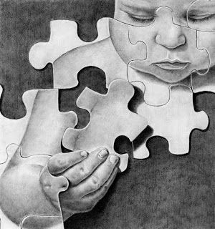
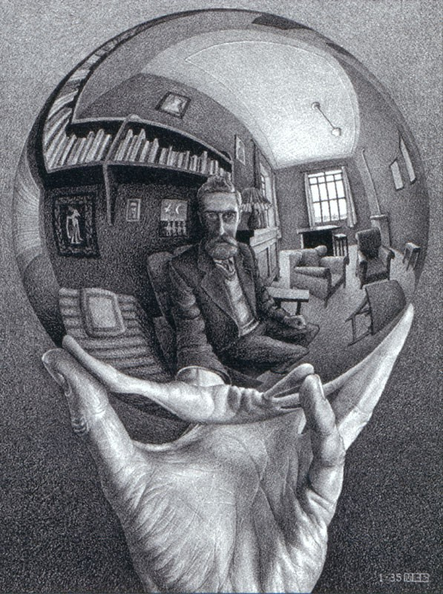
The Self as a Work of Art
‘Customizing’ your self means treating your ‘self’ as an art project -something you build
To do so, you must accept that the ‘real you’ does not yet exist
An authentic self is something you could create out of the raw material of the current ‘you’
It is not something ‘hidden deep within’ that you discover
it is ‘immeasurably high above’ what you presently think you are

Slide 14
The Self as a Work of Art
To "give style" to one's character - that is a grand and a rare art!
He who surveys all that his nature presents in its strength and in its weakness, and then fashions it into an ingenious plan, until everything appears artistic and rational, and even the weaknesses enchant the eye - he exercises that admirable art.
Here there has been a great amount of second nature added, there a portion of first nature has been taken away –in both cases with long exercise and daily labour at the task.
Here the ugly, which does not permit of being taken away, has been concealed, there it has been re-interpreted into the sublime…
Notes:
Sonya story

Slide 15
FIRST NATURE
inherited beliefs, desires, values, habits
largely from surrounding culture, a bit from individual biology
SECOND NATURE
the self you deliberately fashion out of first nature
“GIVING STYLE TO ONE’S CHARACTER”
building a self around one’s fundamental passion
editing “first nature” so that it supports the full development and expression of that passion

Slide 16
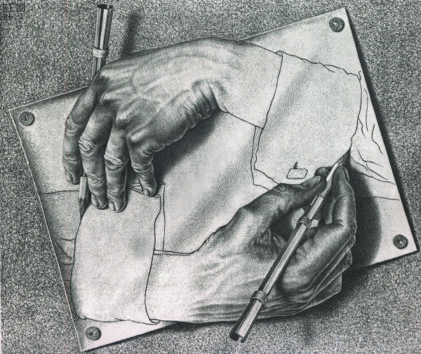
Art and Authenticity
This, for Nietzsche, is properly called authenticity, not “being true” to the self you inherited!
Nietzsche is encouraging us to treat ourselves as artistic projects, where we are author, character, and reader all at once

Slide 17
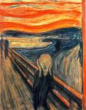
An Artistic View of Life
When we judge that a work of art is great, we don’t mean that it gave us nothing but pleasure:
Great art is often upsetting, confusing, violent, tragic, etc.
We should assess our own lives in this same artistic manner
We enjoy the bad parts of a movie or novel because we respond to the intensity of those moments, and the way in which they reveal character

Slide 18
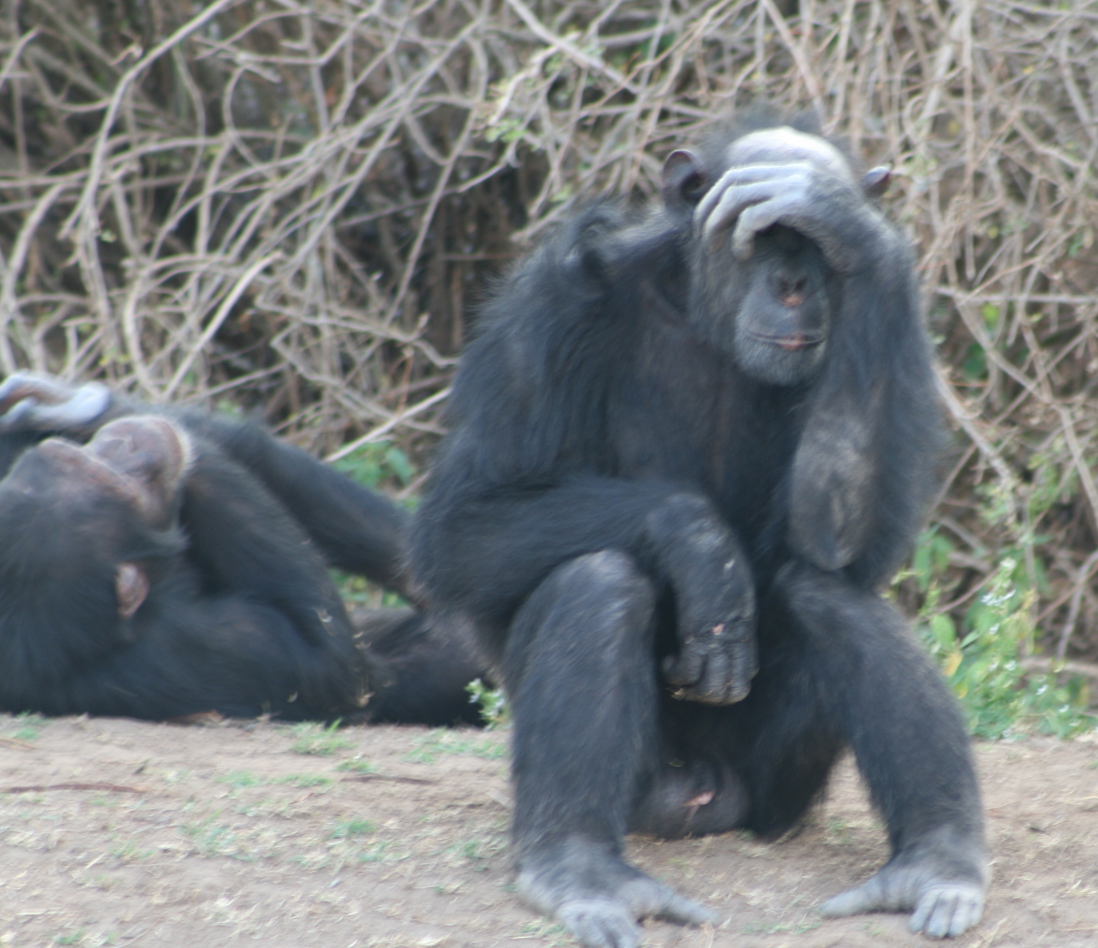
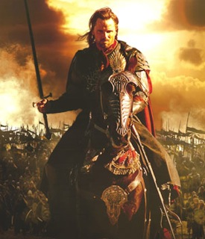
An Artistic View of Life
Most of us just want to get through life with as little pain and embarrassment as possible
With no more ambition than animals, we seek pleasure, and the avoidance of pain, and don’t believe life could have any other purpose
But a rare few desire a life that is so rich in experience that they must constantly change and grow in order to stay on top of it:
higher highs, lower lows, and a thirst to experience everything that is possible for a human being

Slide 19
An Artistic View of Life
As an artist, I may want something other than mere happiness in my life:
I may want intensity and variety in my experiences
Which kind of life do you want?
?
LIFE A LIFE B
1 – 10 4 - 6
?

Slide 20
An Artistic View of Life: A Test
Do you see yourself as a work of art?
Does the joy in your life come from something outside of you?
Does it come from your hopes for what might come later?
Or do you love the life you live now, love the person you have already become?
Are you your favourite thing to look at?
“Chose Life A or B” was my test
Nietzsche provides his own test that will help you discover how you really feel about your life …
Notes:
Rather than a love of the pleasurable moments within it.

Slide 21
THE ETERNAL RETURN
The Heaviest Weight:
What if one day or one night a demon slinked after you into your loneliest loneliness and said to you:
"This life, as you live it now and as you have lived it, you will have to live it once more, and countless times more.

Slide 22
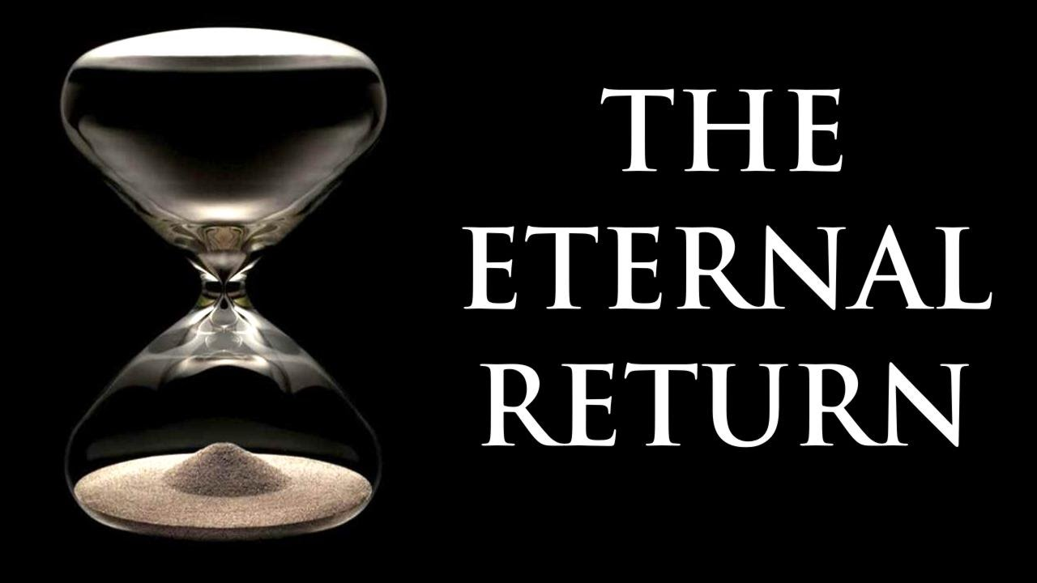
THE ETERNAL RETURN
And there will be nothing new about it, but every pain and every pleasure, and every thought and sigh, and everything unspeakably small and great in your life must come back to you, and all in the same series and sequence –
and likewise this spider and this moonlight between the trees, and likewise this moment and I myself…
The eternal hour-glass of existence is turned over again and again –and you with it, you mote of dust!”
Wouldn’t you throw yourself down and gnash your teeth, and damn the demon that spoke this way?

Slide 23
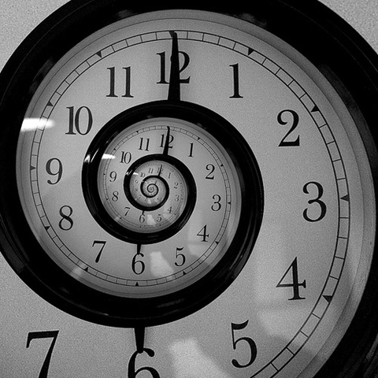
THE ETERNAL RETURN
Or have you ever experienced a prodigious moment in which you would answer him: "You are a God, and I have never heard anything more godlike!"
If that thought took control of you, it would change you as you are, and maybe shatter you.
The question in each and every thing, "Do you will this once more and countless times more?" would lie as the heaviest weight upon your acts!
Or how benevolent would you have to become toward yourself and toward life in order to long for nothing more ardently than for this last ultimate eternal sanction and seal?
[The Gay Science: 341]

Slide 24
An Artistic View of Life

